Slide 1
Your stress is your friend

Slide 2
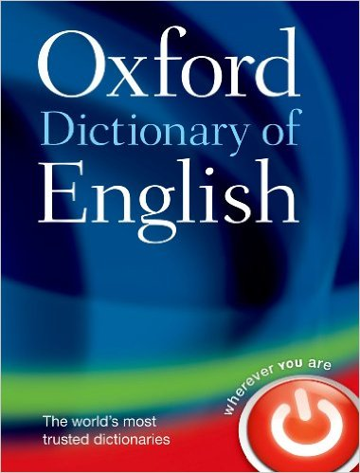
What Is Stress?
▸ noun [mass noun]
1 pressure or tension exerted on a material object
2 a state of mental or emotional strain or tension resulting from adverse or demanding circumstances

Slide 3
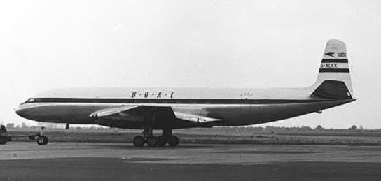
Physical Stress

Slide 4
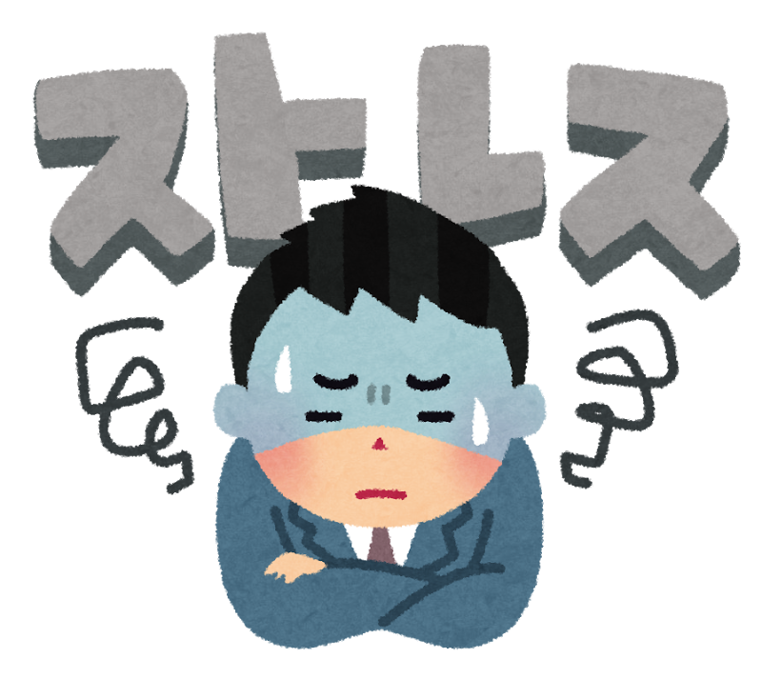
Mental Stress

Slide 5
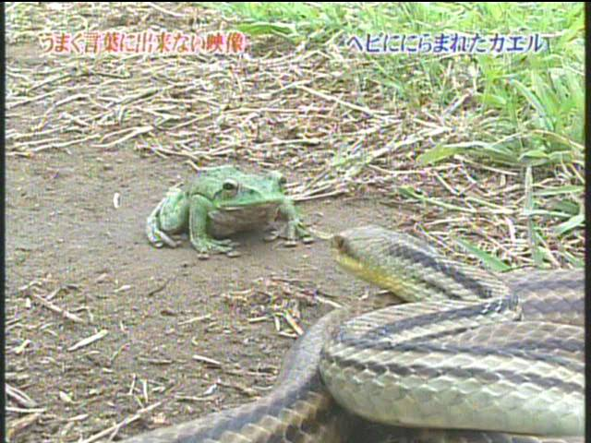

Slide 6
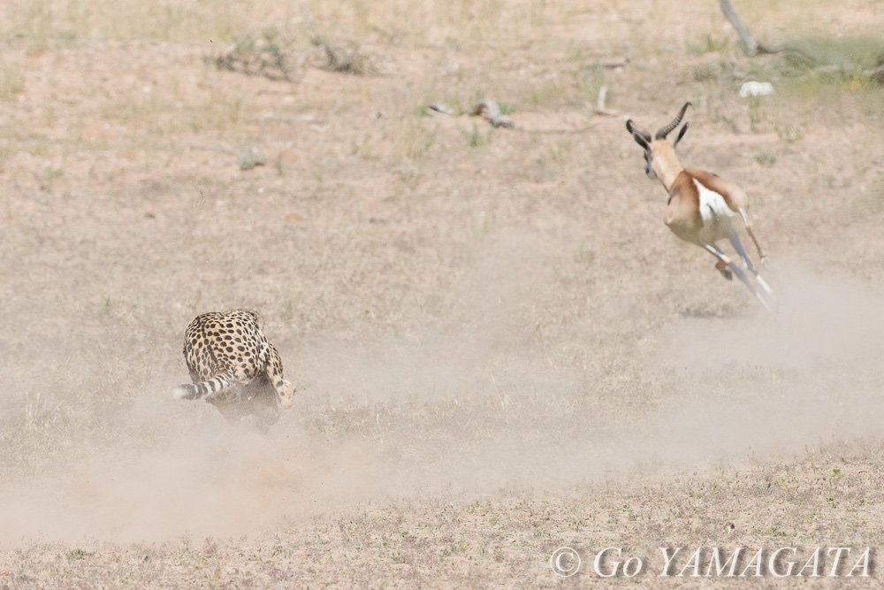

Slide 7


Slide 8
Mindset

Slide 9
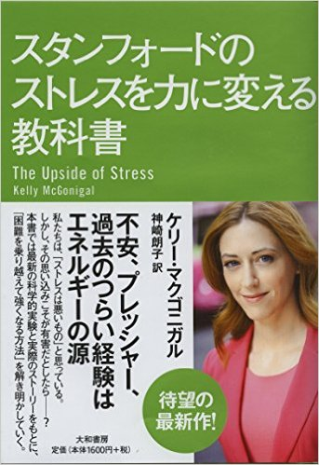

Slide 10
